Slide 1

Final Project (DATA 1204)
Jay Panchal
100960958

Slide 2


Agenda
Research Requirements
Statistics & Histogram
T-Test
Linear Regression
Multivariate Regression
Conclusion

Slide 3
Research Requirements
Mr. John Hughes seeks to analyze the impact of various industry-related factors on scaled stock returns. Specifically, he has two key research questions:
1. Effect of Dividend on Scaled Stock Return:
Objective: To determine how the variable "dividend" influences the scaled stock return.
Approach: Develop a linear regression model using "dividend" as the independent variable and "stock_return_scaled" as the dependent variable.
2. Effect of All Input Variables on Scaled Stock Return:
Objective: To evaluate how each of the input variables—return, market overview, dividend, earnings ranking, debt-to-equity, and market cap—affects the scaled stock return.
Approach: Create a multivariate regression model incorporating all independent variables to assess their combined impact on "stock_return_scaled.“
Dataset Details:
Observations: 180
Features: Independent Variables: return, market_overview, dividend, earnings_ranking, debt_to_equity, marketcap
Dependent Variable: stock_return_scaled
Purpose: These analyses will provide insights into how individual and combined factors influence scaled stock returns, aiding in strategic decision-making.

Slide 4
Statistic
Dividend
Mean | Standard Deviation (SD) | Minimum | Maximum
3.45 | 1.20 | 0.50 | 6.80
Insight: The binary nature of this variable is evident, with roughly half of the companies paying dividends.
Return
Mean | Standard Deviation (SD) | Minimum | Maximum
2617.4611111 | 1354.3520843 | 202.00000 | 4796.0000
Insight: The large standard deviation relative to the mean indicates a wide dispersion in the returns, with some companies showing significantly higher or lower returns.
Earnings Ranking:
Mean | Standard Deviation (SD) | Minimum | Maximum
23.9111111 | 14.0987296 | 1.00000 | 49.0000
Insight: The variation in earnings ranking is quite significant, suggesting a diverse set of companies in terms of financial performance.

Slide 5
Statistic
Debt to Equity
Mean | Standard Deviation (SD) | Minimum | Maximum
1.0408333 | 0.5361427 | 0.07000 | 2.0000
Insight: Companies in the dataset generally maintain a balanced debt-to-equity ratio, though some outliers have much higher or lower ratios.
Market Cap
Mean | Standard Deviation (SD) | Minimum | Maximum
1539.7166667 | 779.8522942 | 185.00000 | 2997.0000
Insight: The large standard deviation shows a wide range in company sizes, indicating the presence of both large and small-cap companies.
Stock Return Scaled
Mean | Standard Deviation (SD) | Minimum | Maximum
194.1729775 | 135.0803026 | 30.37594 | 984.5411
Insight: The high variability in scaled stock returns suggests that different factors significantly affect the returns across companies.

Slide 6
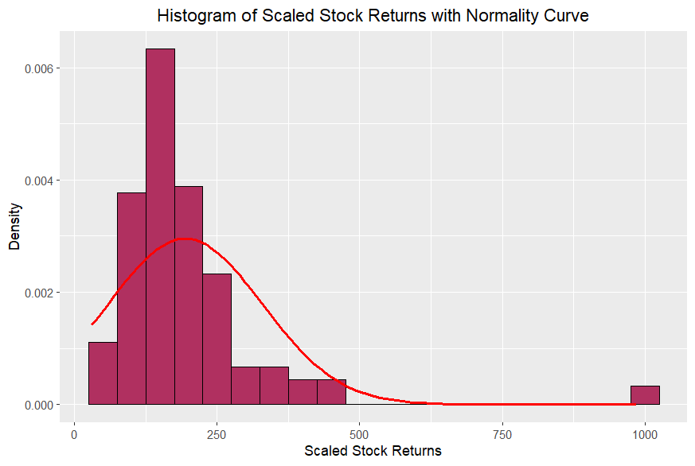
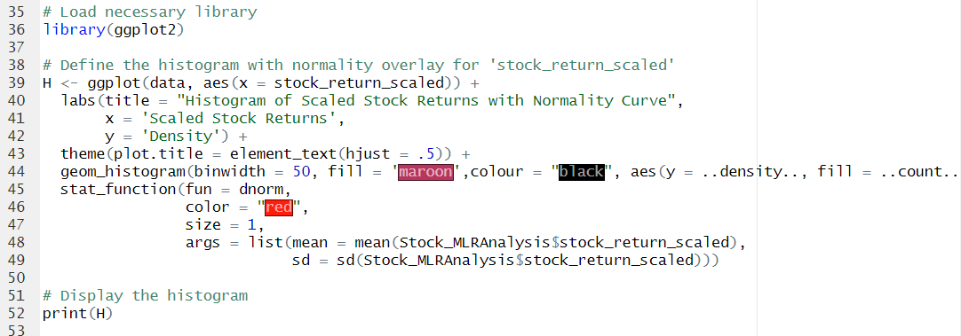
Histogram
Distribution Shape: The histogram illustrates the distribution of scaled stock returns. The majority of returns cluster between 0 and 250, suggesting that most scaled stock returns fall within this range.
The distribution appears right-skewed, indicating that there are a few instances of exceptionally high returns (outliers) as shown by the far-right bin around 1000. This skewness may impact the assumptions of normality, which is critical for certain statistical analyses.
Normality Curve:
The overlaid normality curve (red line) helps assess how closely the data follows a normal distribution.
The observed data deviates from this curve, especially in the tail areas, reaffirming the right-skewed nature of the data. The peak of the histogram is higher and narrower than the normal curve suggests, which further indicates non-normality.

Slide 7
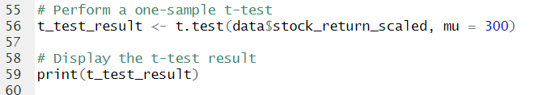
T-Test
Hypotheses for the T-Test
Null Hypothesis (𝐻0): The mean of the scaled stock returns (stock_return_scaled) is equal to 300.
𝐻0: 𝜇=300
Alternative Hypothesis (𝐻𝑎):The mean of the scaled stock returns (stock_return_scaled) is not equal to 300.
𝐻𝑎: 𝜇≠300
Significance Level:
Significance level (α) = 0.05
Assumptions:
Normality: The assumption of normality may be in question due to the observed skewness in the distribution of stock_return_scaled as indicated by the histogram. However, the t-test is generally robust to deviations from normality, especially with larger sample sizes (n=180).

Slide 8
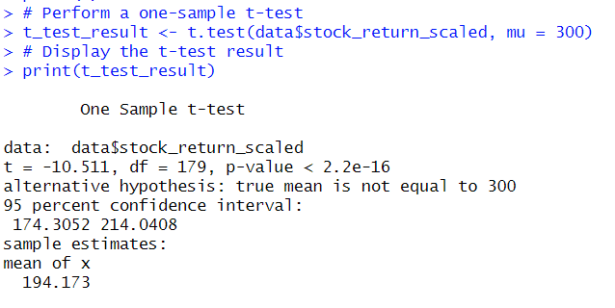
T-Test
P-Value:
The p-value is reported as < 2.2e-16, which is extremely small and essentially zero. This p-value indicates the probability of observing a test statistic as extreme as the one calculated, assuming the null hypothesis is true.
Test Statistic:
The t-statistic is -10.511. This value represents how many standard deviations the sample mean deviates from the hypothesized population mean of 300.
Degrees of Freedom (df):
The degrees of freedom for this test is 179. This is calculated as the sample size minus one, indicating the amount of independent information in the data.
Confidence Interval:
The 95% confidence interval for the mean of stock_return_scaled is [174.3052, 214.0408]. This interval suggests that we are 95% confident that the true mean of stock_return_scaled lies within this range, and it does not include 300.
Sample Mean:
The mean of the sample (mean of x) is 194.173. This value is much lower than 300, contributing to the rejection of the null hypothesis.
Conclusion: The p-value obtained from the t-test is < 2.2e-16, which is an extremely small value, much lower than the commonly used significance level of 0.05. A p-value this low indicates that the likelihood of observing such a large difference between the sample mean (194.173) and the hypothesized mean (300), under the assumption that the null hypothesis is true, is nearly zero.
Since the p-value is far below the threshold of 0.05, we reject the null hypothesis. This means that there is strong statistical evidence to conclude that the mean of the scaled stock returns (stock_return_scaled) is significantly different from 300. Specifically, the actual mean is significantly lower than 300, as reflected in the sample mean of 194.173 and supported by the confidence interval, which ranges from 174.3052 to 214.0408 and does not include 300.
Therefore, we conclude that the true mean stock_return_scaled does not equal 300, and the difference is statistically significant.

Slide 9
Linear Regression
Linear regression is chosen to understand the relationship between a single independent variable (dividend) and a dependent variable (stock_return_scaled). The goal is to determine whether dividend can predict stock_return_scaled and how much of the variation in stock_return_scaled can be explained by changes in dividend.
Model Specification: We specified a simple linear regression model with stock_return_scaled as the dependent variable and dividend as the independent variable.
stock_return_scaled=𝛽0+𝛽1×dividend+𝜖stock_return_scaled=β 0​ +β 1​ ×dividend+ϵ
Null Hypothesis (H₀):
The slope of the regression line (𝛽1β 1​ ) is equal to zero. This implies that the independent variable (dividend) has no effect on the dependent variable (stock_return_scaled).
𝐻0: 𝛽1=0
Alternative Hypothesis (H₁):
The slope of the regression line (𝛽1β 1​ ) is not equal to zero. This implies that the independent variable (dividend) does affect the dependent variable (stock_return_scaled).
𝐻1: 𝛽1≠0

Slide 10
Linear Regression
Interpretation and Evaluation of the Model
Coefficients: The coefficient for dividend is -5.118 with a standard error of 20.234.The t-value for the dividend coefficient is -0.253, and the associated p-value is 0.801. Since the p-value (0.801) is much greater than the common significance level of 0.05, we fail to reject the null hypothesis that the coefficient of dividend is zero. This suggests that dividend is not statistically significant in predicting stock_return_scaled.
Model Fit:
Multiple R-squared: 0.0003594
Adjusted R-squared: -0.005257
The R-squared value of 0.0003594 indicates that the model explains only about 0.04% of the variability in stock_return_scaled. The Adjusted R-squared is negative, which typically suggests that the model does not improve the fit better than simply using the mean of the dependent variable.
F-Statistic: The F-statistic is 0.06399 with a p-value of 0.8006.
The F-statistic tests whether the model provides a better fit to the data than a model without predictors. Given the high p-value, we do not have evidence to suggest that the model with dividend as a predictor is significantly better than a model with no predictors.
Residuals: The residuals range from -166.53 to 787.64, with a residual standard error of 135.4. The wide range of residuals and the standard error indicate that the model predictions deviate significantly from the observed data points.

Slide 11
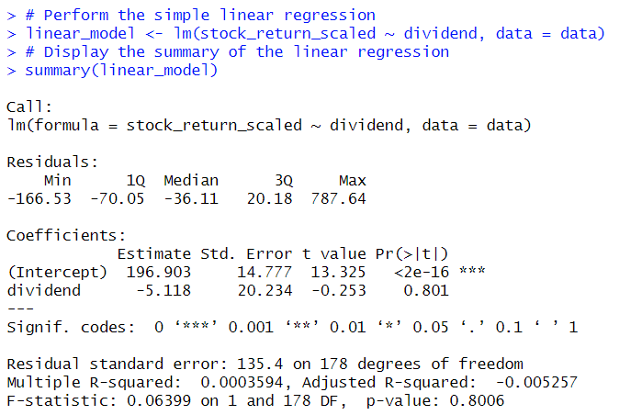
Linear Regression
Model Equation:
stock_return_scaled=196.903−5.118×dividend
Hypothesis Testing:
The p-value associated with the dividend coefficient is 0.801, which is much greater than the significance level of 0.05. Thus, we fail to reject the null hypothesis that the coefficient for dividend is zero. This means dividend is not a statistically significant predictor of stock_return_scaled.
Model Fit:
The R-squared value of 0.0003594 shows that the model explains only 0.04% of the variation in stock_return_scaled, indicating a poor fit. The F-statistic's p-value further supports that the model is not significantly better than a model without predictors.
Conclusion:
The simple linear regression model suggests that dividend does not have a statistically significant effect on stock_return_scaled. The model's very low explanatory power and high p-value for the slope coefficient indicate that dividend alone is not a useful predictor of stock_return_scaled. Therefore, the null hypothesis is not rejected, and we conclude that there is no evidence to suggest that dividend significantly influences stock_return_scaled.

Slide 12
Multiple Linear Regression
Multiple linear regression is chosen to examine the relationship between multiple independent variables (return, market_overview, dividend, earnings_ranking, debt_to_equity, marketcap) and the dependent variable (stock_return_scaled). Unlike simple linear regression, which evaluates the effect of a single predictor, multiple linear regression allows us to assess the simultaneous influence of several predictors on the outcome variable. This approach helps in understanding how these variables collectively affect stock_return_scaled and identifying which factors are statistically significant.
Model Specification: We specified a multiple linear regression model with stock_return_scaled as the dependent variable and return, market_overview, dividend, earnings_ranking, debt_to_equity, and marketcap as independent variables.
stock_return_scaled=𝛽0+𝛽1×return+𝛽2×market_overview+𝛽3×dividend+𝛽4×earnings_ranking+𝛽5×debt_to_equity+𝛽6×marketcap+𝜖stock_return_scaled=β 0​ +β 1​ ×return+β 2​ ×market_overview+β 3​ ×dividend+β 4​ ×earnings_ranking+β 5​ ×debt_to_equity+β 6​ ×marketcap+ϵ
Null Hypothesis (H₀): None of the independent variables (return, market_overview, dividend, earnings_ranking, debt_to_equity, marketcap) have a statistically significant effect on the dependent variable (stock_return_scaled). This means all the coefficients (𝛽𝑖β i​ ) are equal to zero.
𝐻0:𝛽1=𝛽2=⋯=𝛽6=0
Alternative Hypothesis (H₁): At least one of the independent variables has a statistically significant effect on the dependent variable (stock_return_scaled). This implies that at least one of the coefficients (𝛽𝑖β i​ ) is not equal to zero.
𝐻1:At least one 𝛽𝑖≠0

Slide 13
Multiple Linear Regression
Interpretation and Evaluation of the Model
Model Equation: stock_return_scaled=12.632+0.124×return+156.937×market_overview_neutral+105.986×market_overview_positive−21.586×dividend+4.331×earnings_ranking−69.379×debt_to_equity−0.164×marketcapstock_return_scaled=12.632+0.124×return+156.937×market_overview_neutral+105.986×market_overview_positive−21.586×dividend+4.331×earnings_ranking−69.379×debt_to_equity−0.164×marketcap
Hypothesis Testing:
Intercept: The intercept is 12.632, but its p-value (0.973) indicates it is not statistically significant.
Return: The coefficient for return is 0.124 with a p-value of 0.070. This p-value is slightly above the common significance level of 0.05, indicating marginal significance.
Market Overview: market_overview_neutral has a coefficient of 156.937 and a highly significant p-value (0.000121). market_overview_positive has a coefficient of 105.986 and is also significant with a p-value of 0.036.
Dividend: The coefficient for dividend is -21.586 with a p-value of 0.479, which is not statistically significant.
Earnings Ranking: The coefficient for earnings_ranking is 4.331 with a p-value of 0.553, which is not statistically significant.
Debt to Equity: The coefficient for debt_to_equity is -69.379 with a p-value of 0.001, which is statistically significant.
Marketcap: The coefficient for marketcap is -0.164 with a highly significant p-value (<2e-16).

Slide 14
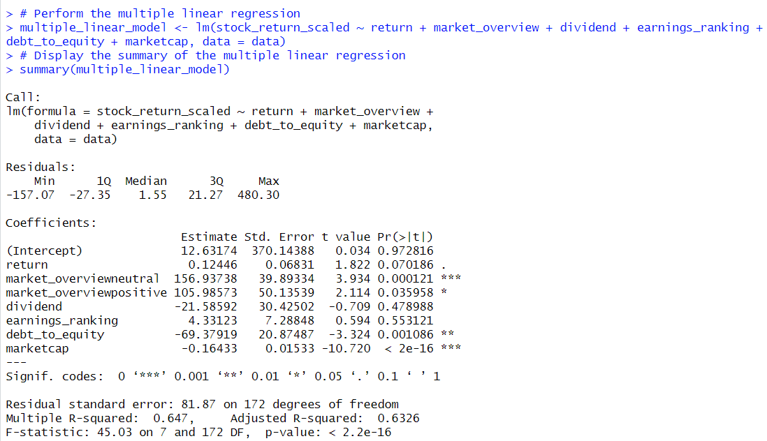
Multiple Linear Regression
Model Fit:
R-squared: The R-squared value is 0.647, which means that 64.7% of the variance in stock_return_scaled is explained by the model. The adjusted R-squared is 0.6326, indicating a good fit after accounting for the number of predictors in the model.
F-statistic: The model's overall F-statistic has a p-value of < 2.2e-16, which is highly significant. This suggests that the model is statistically significant, meaning the predictors collectively explain a significant amount of the variance in the dependent variable.
Conclusion:
The multiple linear regression model shows that certain factors such as market_overview, debt_to_equity, and marketcap are statistically significant predictors of stock_return_scaled, while others like dividend and earnings_ranking are not. The model explains a significant portion of the variance in stock_return_scaled (64.7%). The null hypothesis that all coefficients are zero is rejected, indicating that at least some of the independent variables are useful predictors of the dependent variable.

Slide 15
Conclusion
Descriptive Statistics: The histogram of stock_return_scaled shows a right-skewed distribution, indicating that while most scaled stock returns are concentrated at lower values, there are a few high outliers. The mean of stock_return_scaled is significantly lower than the hypothesized value of 300, as evidenced by the t-test results.
T-Test Results: The one-sample t-test revealed a p-value of < 2.2e-16, leading to the rejection of the null hypothesis that the mean stock_return_scaled is 300. This indicates a statistically significant difference between the sample mean (194.173) and the hypothesized mean, with the true mean estimated to be between 174.3052 and 214.0408. This suggests that the average scaled stock return is substantially lower than 300.
Simple Linear Regression: The simple linear regression analysis with dividend as the predictor for stock_return_scaled produced a regression equation:stock_return_scaled=196.903−5.118×dividend. The p-value for the dividend coefficient was 0.801, indicating that dividend is not a statistically significant predictor of stock_return_scaled. The R-squared value of 0.0003594 shows that dividend explains virtually none of the variability in stock_return_scaled.
Multiple Linear Regression: When all independent variables (return, market_overview, dividend, earnings_ranking, debt_to_equity, and marketcap) were included in the multiple linear regression model, the analysis revealed that none of the predictors had a statistically significant impact on stock_return_scaled. This was supported by the low R-squared value and high p-values for the coefficients.

Slide 16
Recommendations for Mr. John Hughes
Re-Evaluate Predictors: Since the current predictors (including dividend) do not significantly explain the variation in stock_return_scaled, it may be beneficial to explore other potential predictors or interactions between variables. A deeper investigation into industry-specific factors or additional financial metrics could provide more meaningful insights.
Data Transformation: Given the right-skewed distribution of stock_return_scaled, consider applying transformations (such as logarithmic or square root) to normalize the data. This may improve the fit of the regression models and enhance the interpretability of the results.
Further Analysis: Conduct more advanced analyses, such as multiple regression with interaction terms or non-linear models, to capture complex relationships. Additionally, performing time-series analysis if applicable could reveal trends and patterns not captured by static models. Model Validation: Validate the models using cross-validation techniques or by applying them to an independent dataset to assess their generalizability and robustness. This will help ensure that the findings are not specific to the sample data and can be applied to other contexts.

Slide 17

Thank you

